Slide 1

Information on Accident Prevention and Work and Fire Safety for Students

Slide 2
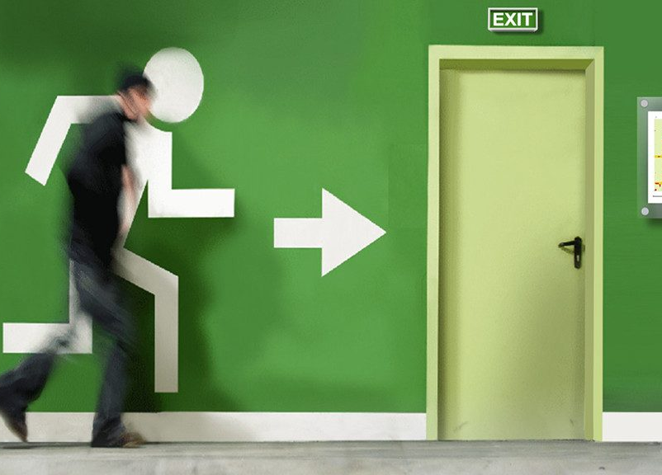
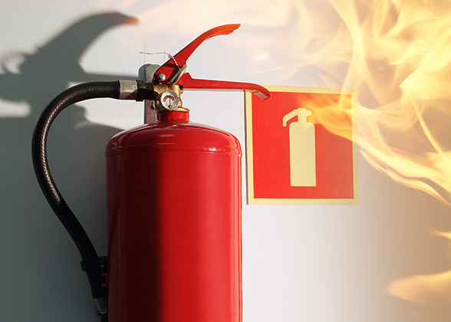
Dear Students,
Safety and security are of primary concern during education at Károli Gáspár University of the Reformed Church in Hungary.
Many of us, as employees, students or visitors, are involved in many ways to ensure that fire safety is maintained and improved.
In the event of an emergency, it is a key issue to have the basic knowledge needed to deal effectively with the situation. For this reason, we have compiled a security and fire safety training material which you can read below!
INTRODUCTION

Slide 3
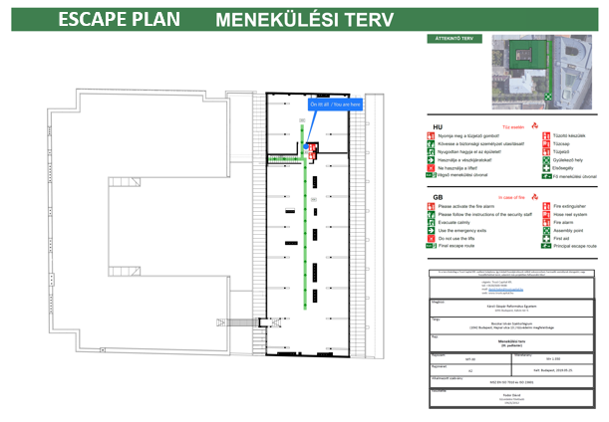
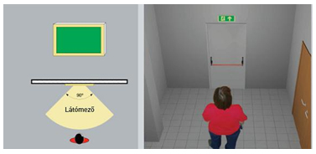
ESCAPE PLAN
ORIENTATION, GETTING TO KNOW THE BUILDING
The first and most important thing to do when visiting any property is to find out about the fire safety features of the building.
The „Escape Plans” posted on the escape routes will provide guidance.
Study the characteristics of the building, get know the necessary actions and escape routes in case of an emergency!

Slide 4
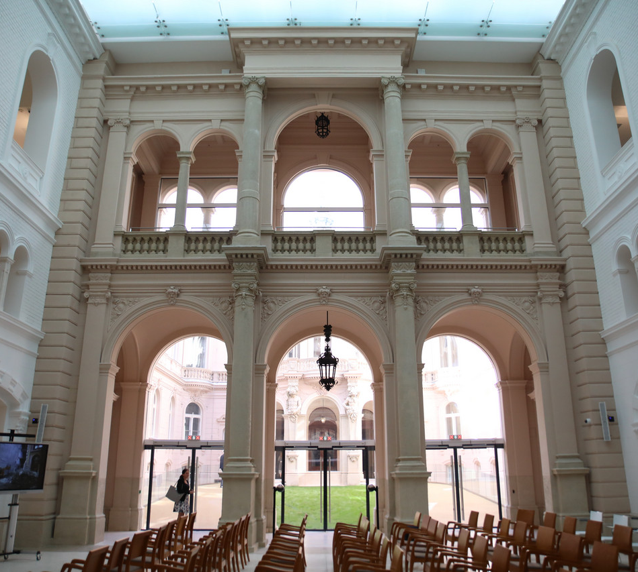
ORIENTATION,
GETTING TO KNOW THE BUILDING
Find out emergency exits!
Elevators cannot be used in case of fire. In multi-storey buildings look for the staircases that can be used for escape!
Learn to use a fire extinguisher!
Everyone in the building should participate in fire drills. An important part of fire prevention is to practice leaving the buildings as quickly as possible in an organised way. Please take the fire safety drills seriously.
In the event of fire, if you have to leave the building, cover your mouth with a cloth (preferably damned), or with your clothes, and try to breathe through it, so that you can escape safely (reducing the risk of smoke inhalation).

Slide 5
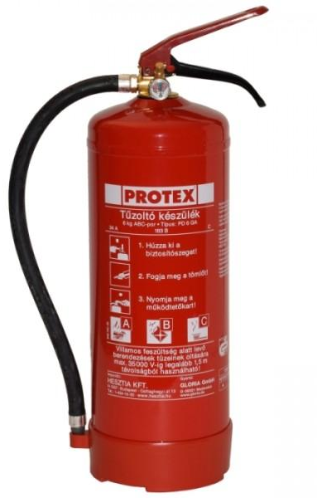
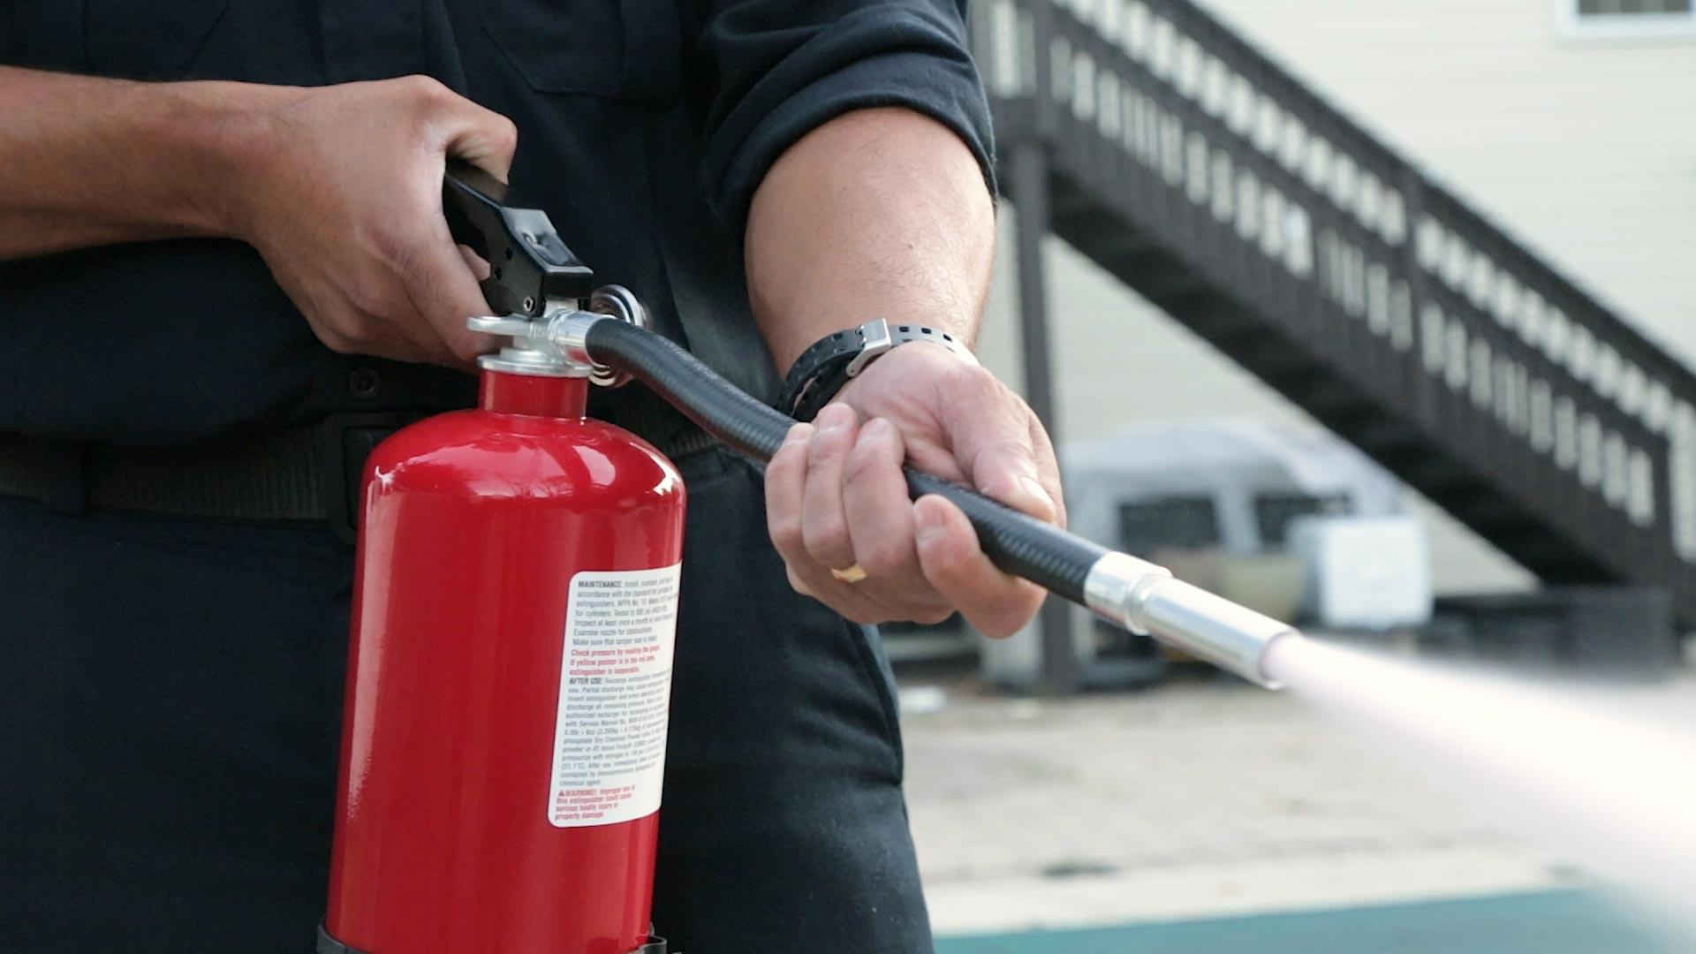
HOW TO USE A 6 KG ABC CHEMICAL POWDER FIRE EXTINGUISHER?
Shake the device to mix up the powder!
Remove the pin!
Approach the fire by bending down or crouching, while shooting a few small rounds in front of you to reduce the heat load on your body.
Aim the nozzle at the base of the fire and start extinguishing in stages!
Attention! An extinguished fire can reignite at any time!

Slide 6
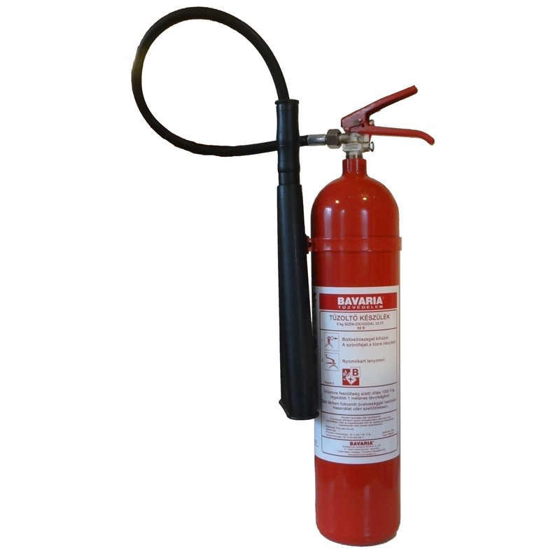
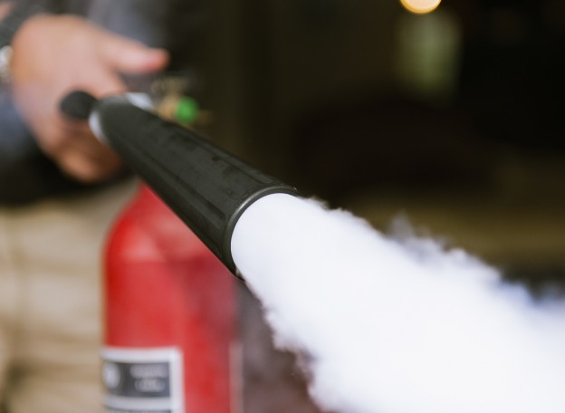
HOW TO USE A 2 KG CARBON DIOXIDE (CO2) FIRE EXTINGUISER?
When using carbon dioxide, we need to get closer to the fire as it evaporates very quickly.
Only grip structural parts designed for gripping. The temperature of the carbon dioxide is around -78 Celsius, which can cause severe frostbite.
In confined air spaces, it displaces oxygen and may be hazardous to breathing.

Slide 7
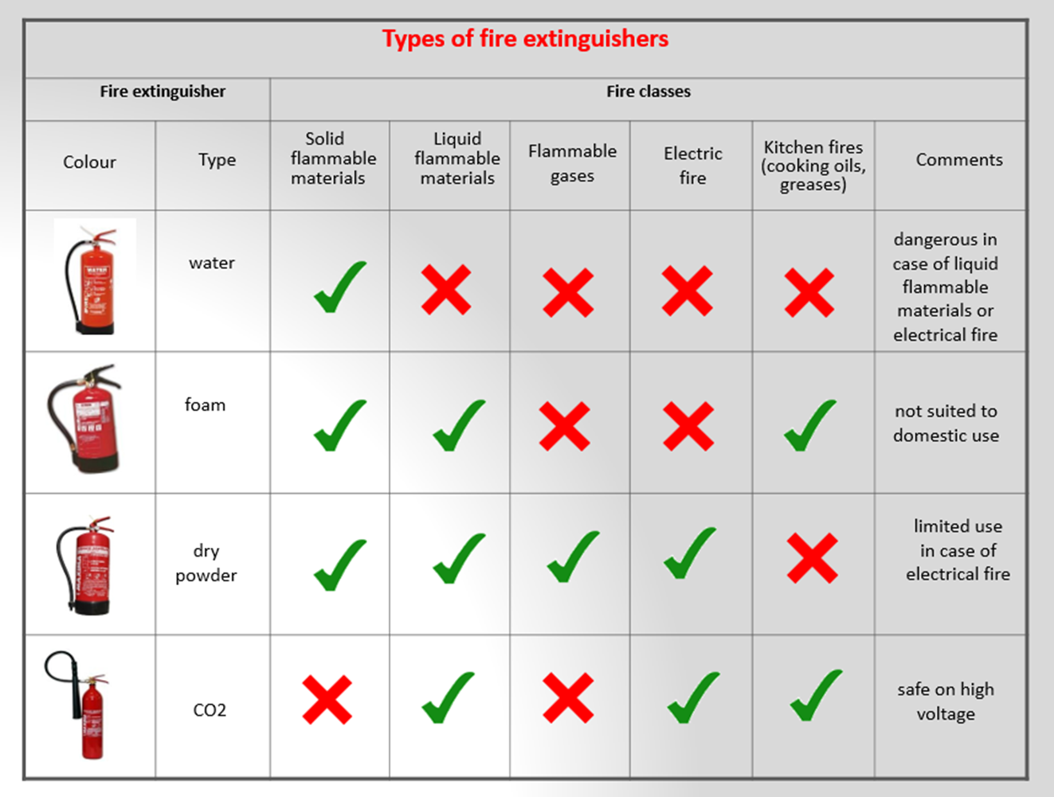
FIRE EXTINGUISHER CHART

Slide 8

WHAT TO DO IN AN EMERGENCY
At the university, it is basically the caretaker/reception that takes action in the event of an emergency.
If a student detects a fire, press the manual call point to sound the fire alarm sirens and then try to extinguish the fire.
In the absence of a fire alarm system/manual call point, the emergency should be reported by phone to 112 and to the caretaker of the property.
Follow the instructions of the managers without delay.
Participate in lifesaving, maintaining control and security when required, at the request of the university management staff or the fire fighters.
Fire fighting and rescue tasks should only be carried out without endangering your own safety.

Slide 9


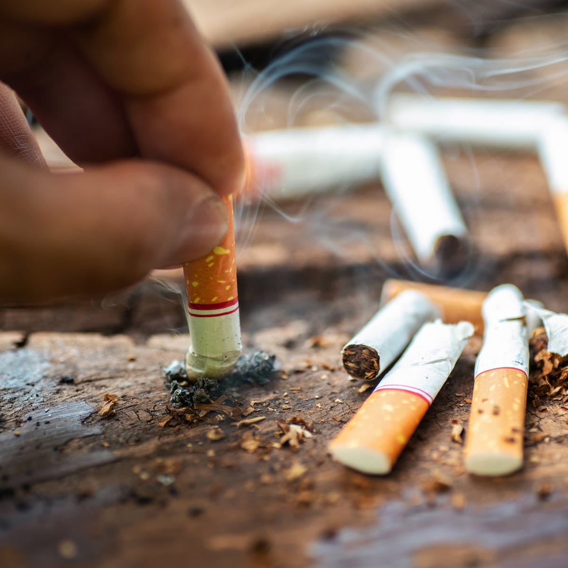
SMOKING
Smoking is not allowed inside the buildings, only in designated outdoor areas. Make sure that a tidy environment welcomes those arriving after you.

Slide 10
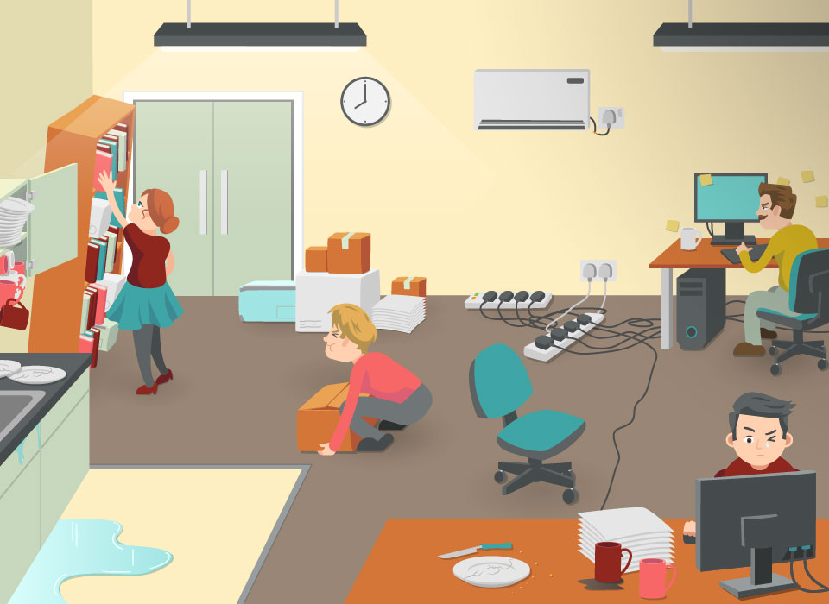
SAFETY IN CLASSROOMS
What devices do we encounter in the university environment and, in this context, what safety rules do we need to take into account?
Never stand on the swivel chair!
Take care to keep the electronic cables routed to prevent the risk of tripping! Beware of the risk of hitting your head, arms or legs!
Cables: do not have any trip hazard electrical cables or extension cords in the environment. Wind the right size and safely route excessively long cables. In case of a temporary extension, make sure that the cable running in the route is fixed with a yellow/black tape.
Ladders: Use a ladder instead of a chair, table or box if you need to reach a higher place. Make sure you choose the right ladder. You may need a twin ladder or a straight ladder , but is may also be advisable to use a stepladder.
Shelves: when storing documents, always make sure that the maximum load capacity specified by the manufacturer is not exceeded. Remember to clearly mark the load capacity of the shelves if it is not visible.
Another important rule is that protection against falling must be provided, typically by fixing them to the wall.

Slide 11

SAFETY DURING STUDENT WORK/PREPARATION - MONITOR
The most important feature related to the monitor is the monitor-eye distance. If the distance is too small, eye strain and inflammation may occur. Major rules for the correct positioning of monitors:
the top edge of the monitor should be at or slightly below eye-level
tilt the monitor so that your gaze is perpendicular to the plane of the monitor
the monitor and the documents should be at the same distance so that your eyes do not have to adjust all the time
the surface of the desk should preferably be matt to avoid reflections
use TFT monitors if possible, as they are radiation-free and less harmful to the eyes
direct sunlight impairs screen visibility
avoid reflections on the screen, the monitor should be in the shade, with natural light coming from the left for right-handed, and from the right for left-handed users. Even if the monitor is in the shade, the sun should not shine from the front
the artificial lighting should be diffused in the room and directed on the desk
look perpendicular to the screen of a monitor, in the most natural posture possible, height-adjustable desks and chairs are a great help
take a break of at least 10 minutes every hour

Slide 12
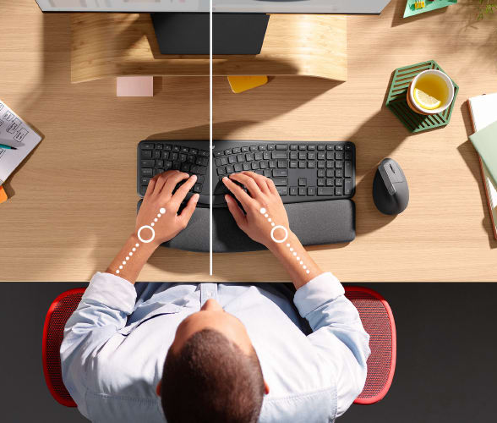
SAFETY DURING STUDENT WORK/PREPARATION –
KEYBOARD, MOUSE
Using the keyboard and the mouse involves different postures.
The positioning of the mouse in relation of the body is a critical factor in the twisting and bending of the shoulder and in the increased strain on the neck and shoulder muscles.
Where the use of the mouse is a priority (e.g. information search tasks, internet browsing), the mouse pad should be moved closer to the user’s midline. This allows the elbows to be supported, resulting in longer periods of use while minimising static muscle strain. In this layout, only the alphanumerical part is convenient to use.
In the other case, where the workstation layout is primarily for typing, both elbows of the user are supported so that paperwork may be placed in front of the keyboard and the keyboard can be used in its entirety.

Slide 13
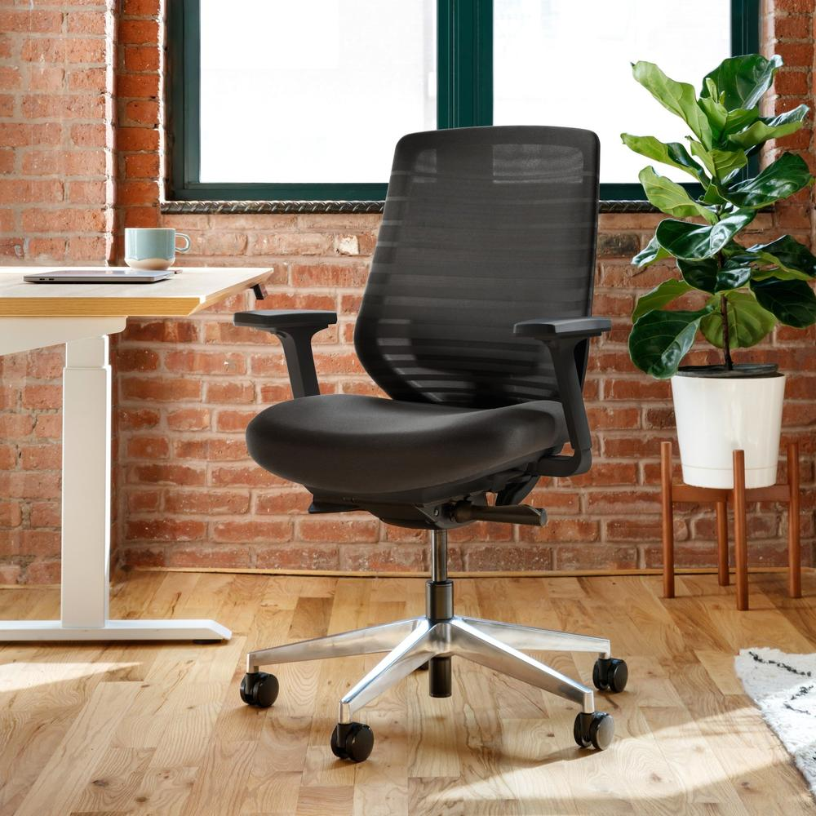
SAFETY DURING STUDENT WORK/PREPARATION – DESK CHAIR
In general, a good desk chair is designed to support the body in a stable, dynamic position that is both comfortable and physiologically appropriate for extended periods of time.
When designing the desk chair, care should be taken to ensure that blood circulation in the legs is not reduced during use, and that postures assumed during sitting are easy to maintain and change.
The chair should support the spine. The surface of the chair should be chosen so that friction is sufficiently high to prevent the user from slipping of the chair.
The use of an ergonomic office chair is highly recommended.

Slide 14
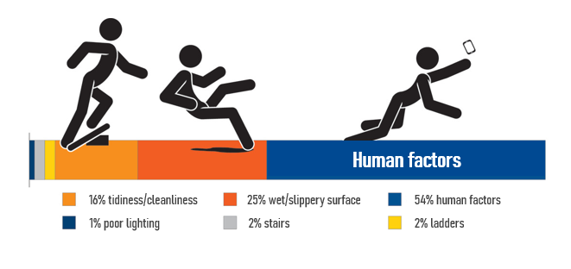
TRIPPING AND SLIPPING HAZARD
Tripping and slipping accidents represent a significant proportion of accidents in the university environment. What can we do to prevent similar situations?
Choose the right shoes, preferably with non-slip soles that are suitable for the weather.
Do not hurry! Take a good look around hard-to-see places (corners, near doors etc.)
Keep the working environment clean and tidy.
Wet, slippery floors: Clean up any spills immediately! Spilled liquid should be marked with a „Caution slip hazard” sign."
Parking lots, outdoors: Be prepared for slippery areas that are hard to spot (ice patches, oil spills etc.) Watch out for pits and potholes while you are on your way somewhere.
Expect icing near the freezing point, be especially careful even on foot.

Slide 15
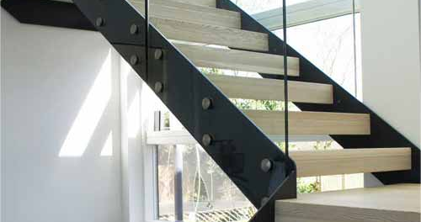
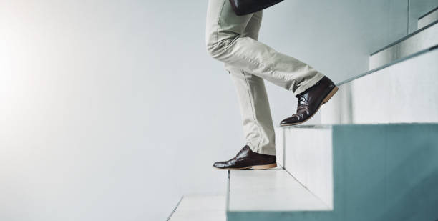
WALKING STAIRS
Stairways are a very common walking surface at the university. Although we may think that climbing stairs is less dangerous, unfortunately we can easily get unpleasant or even serious injuries.
However, the four golden rules of stair climbing safety can help:
Take one step at a time.
Always grip the handrail with one hand for a „three-point-support” which, with a good chance, provides sufficient stability.
Leave your other hand free to dampen the energy of the fall in an unexpected situation.
Do not carry heavy or large objects in your hands! Ask for help if you need to move such a load.

Slide 16


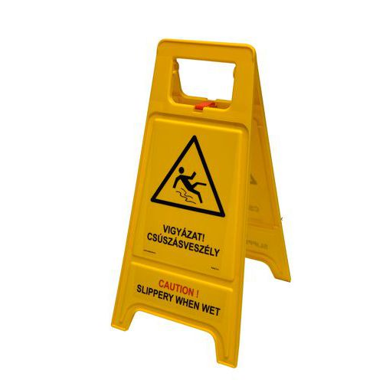
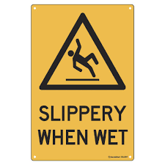
CLOSED OR OTHER RISKY WORK AREAS
Designated work areas may present special hazards and should only be entered by those involved in the construction work and relevant university staff.
When cleaning, there may be slippery surfaces that should be avoided if possible. If this is not possible, please take special care when passing through these areas.

Slide 17
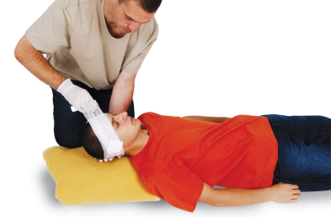

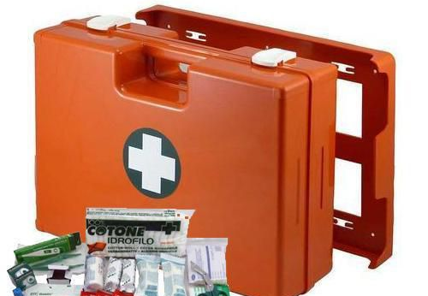

WHAT TO DO IN THE EVENT OF AN ACCIDENT?
Each property has a designated first-aid post and trained staff, check the facilities available within the property.
In the event of an accident, call an ambulance immediately, if necessary, e.g. head injury, electric shock, heavy bleeding etc.
Take care of securing the site of the accident, try to eliminate existing hazards.
Take care of the insured person. If you feel prepared, you can get of course involved in the process of providing first-aid, but be sure to inform the building managers (caretaker or technical staff).
If the emergency has passed and the injured person has been taken care of, notify the relevant student registry/dean’s office.

Slide 18
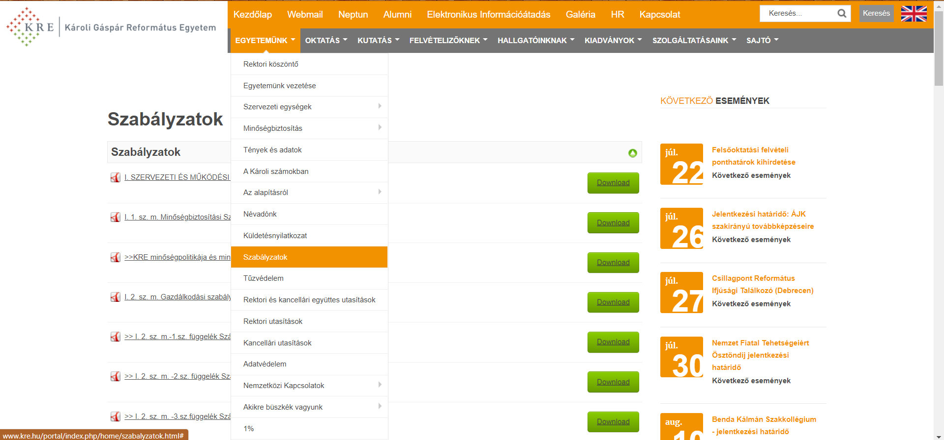
REGULATIONS
Information on the detailed rules on work and fire safety (II.3 Work Safety Rules and II.4 Fire Safety Rules) are available in Hungarian and can be downloaded from the university’s website http://www.kre.hu/portal/index.php/home/szabalyzatok.html.

Slide 19
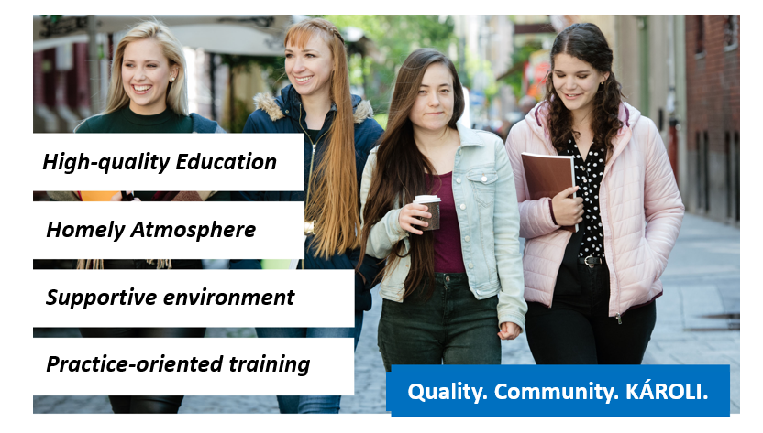
THANK YOU FOR YOUR ATTENTION, HAVE A SAFE TIME AT THE UNIVERSITY!

